Slide 1
Change h=333 to h=335
Benefits
Disadvantages
In eRHIC mode, 9 trains in the ring instead of 5, so 80% more I_{avg} for a given bunch charge
  Actually one train will be the probes so more like 8 vs. 4
Train ordering is reversed so that +1.5 wavelength path length in splitter line #4 adds to the probe bunch separation rather than subtracting
  Gives 9.5 periods (7.3ns) instead of 6.5 periods (5.0ns)
The lattice layout has to be redesigned with 46cm more circumference (23cm more on each racetrack side)

Slide 2
The maths
Harmonic number (circumference in 1.3GHz RF wavelengths) | Injection rate per train | Bunch-to-new-bunch delay within train (1.3GHz RF periods) | Number of trains (including probe bunch “train”) | Injection rate for all trains (including probe bunch “train”)
h=333 | 1.3GHz/335 ~3.881MHz | +2 | 5 (4.25 equiv.) | 1.3GHz/67 ~19.403MHz (335=5*67)
h=335 | 1.3GHz/333 ~3.904MHz | -2 | 9 (8.25 equiv.) | 1.3GHz/37 ~35.135MHz (333=9*37)

Slide 3
Probe bunch details
Harmonic number (circumference in 1.3GHz RF wavelengths) | Number of trains (including probe bunch “train”) | Number of bunches thru linac per turn, avg. injection rate | Bunch charge required to get I_{avg} = 1mA (KPP) in eRHIC mode | Delay from accelerating to decelerating probe (1.3GHz RF periods)
h=333 | 5 | 4*8+2 = 34 ~16.49MHz | 60.64pC | -6.5 = (-4)*(+2)+1.5 -5.00ns
h=335 | 9 | 8*8+2 = 66 ~32.21MHz | 31.05pC | +9.5 = (-4)*(-2)+1.5 ~+7.31ns

Slide 4
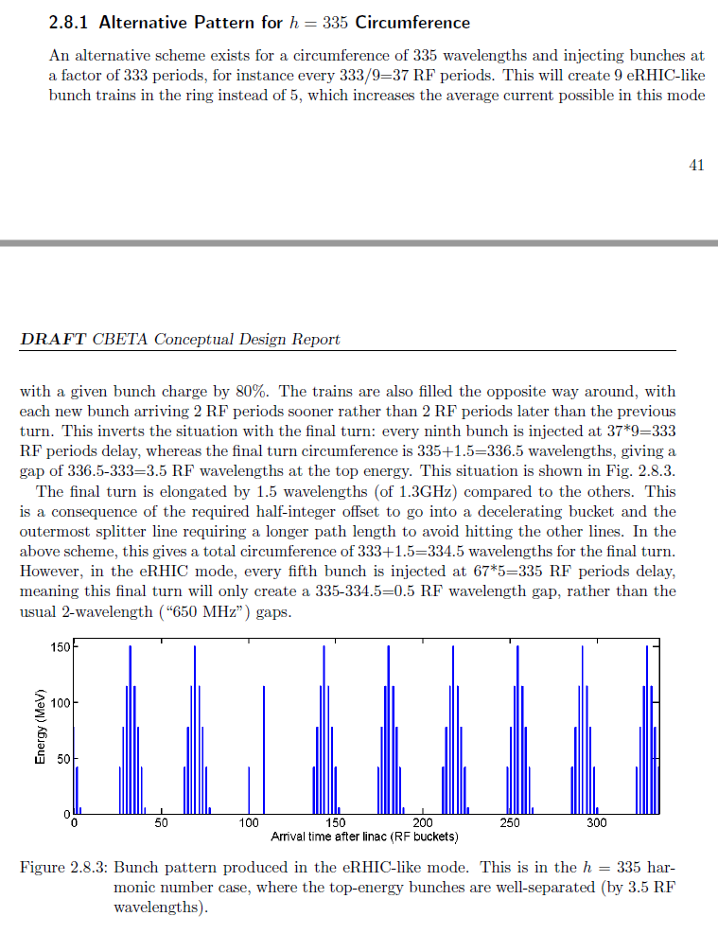
More details in the CDR
Section 2.8.1 (in Acc. Phys. > Bunch patterns

